Slide 1



Slide 2
What to expect from this workshop
Learn about R packages to support Clinical Reporting in R
Create ADaM datasets,
Prepare displays
Interactive shiny apps
Hands-on exercises
How to contribute back to the Pharmaverse!

Slide 3

Workshop Expectations
What to do if you find a ?
Ask questions on discord or raise your hand
Be respectful, follow the Terms and Conditions of Posit::conf
https://rinpharma.com/terms/

Slide 4
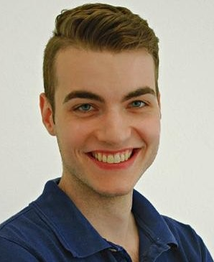
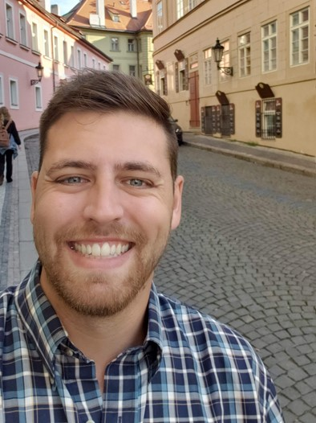
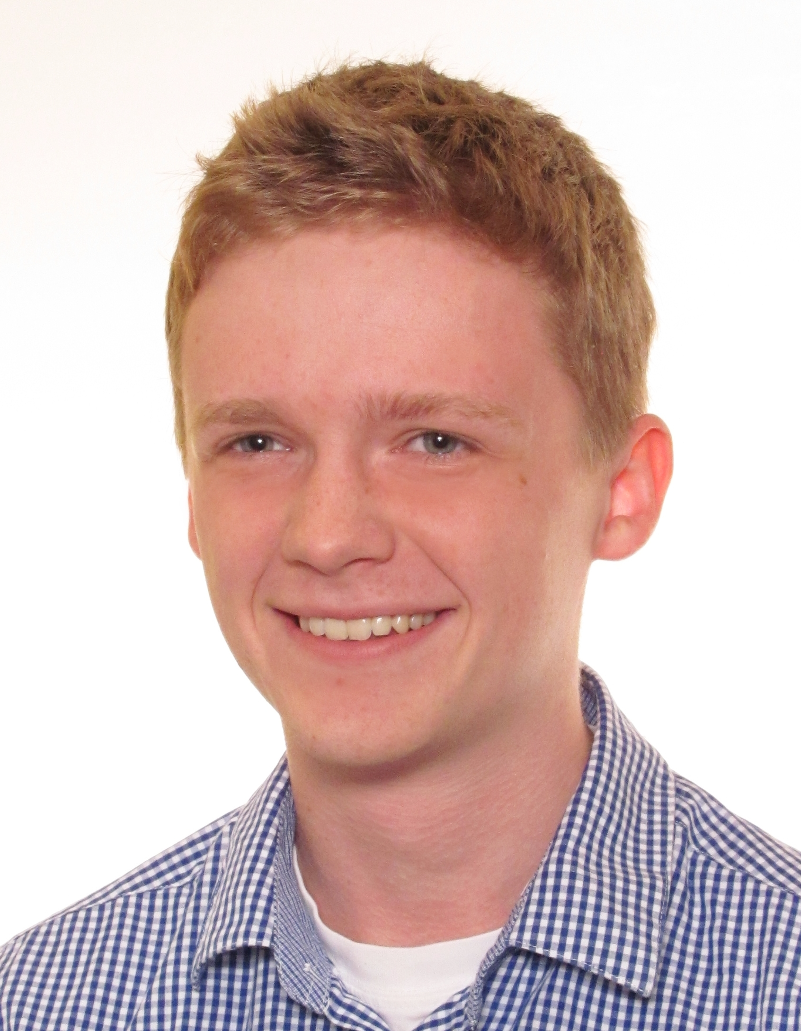
Workshop Instructors
Who are we?
What do we do?
Why are we here?
Ellis Hughes
Thomas Neitmann
Pawel Rucki

Slide 5

Who are you?!
Meet the people around you!

Slide 6

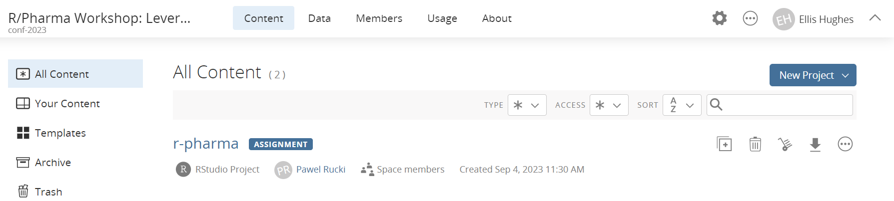
Our environment
For consistency, we’ll be working in RStudio Cloud
We’ve installed and configured everything for you
Following the course, all content from this workshop will be available on GitHub (https://github.com/posit-conf-2023/r-pharma)

Slide 7
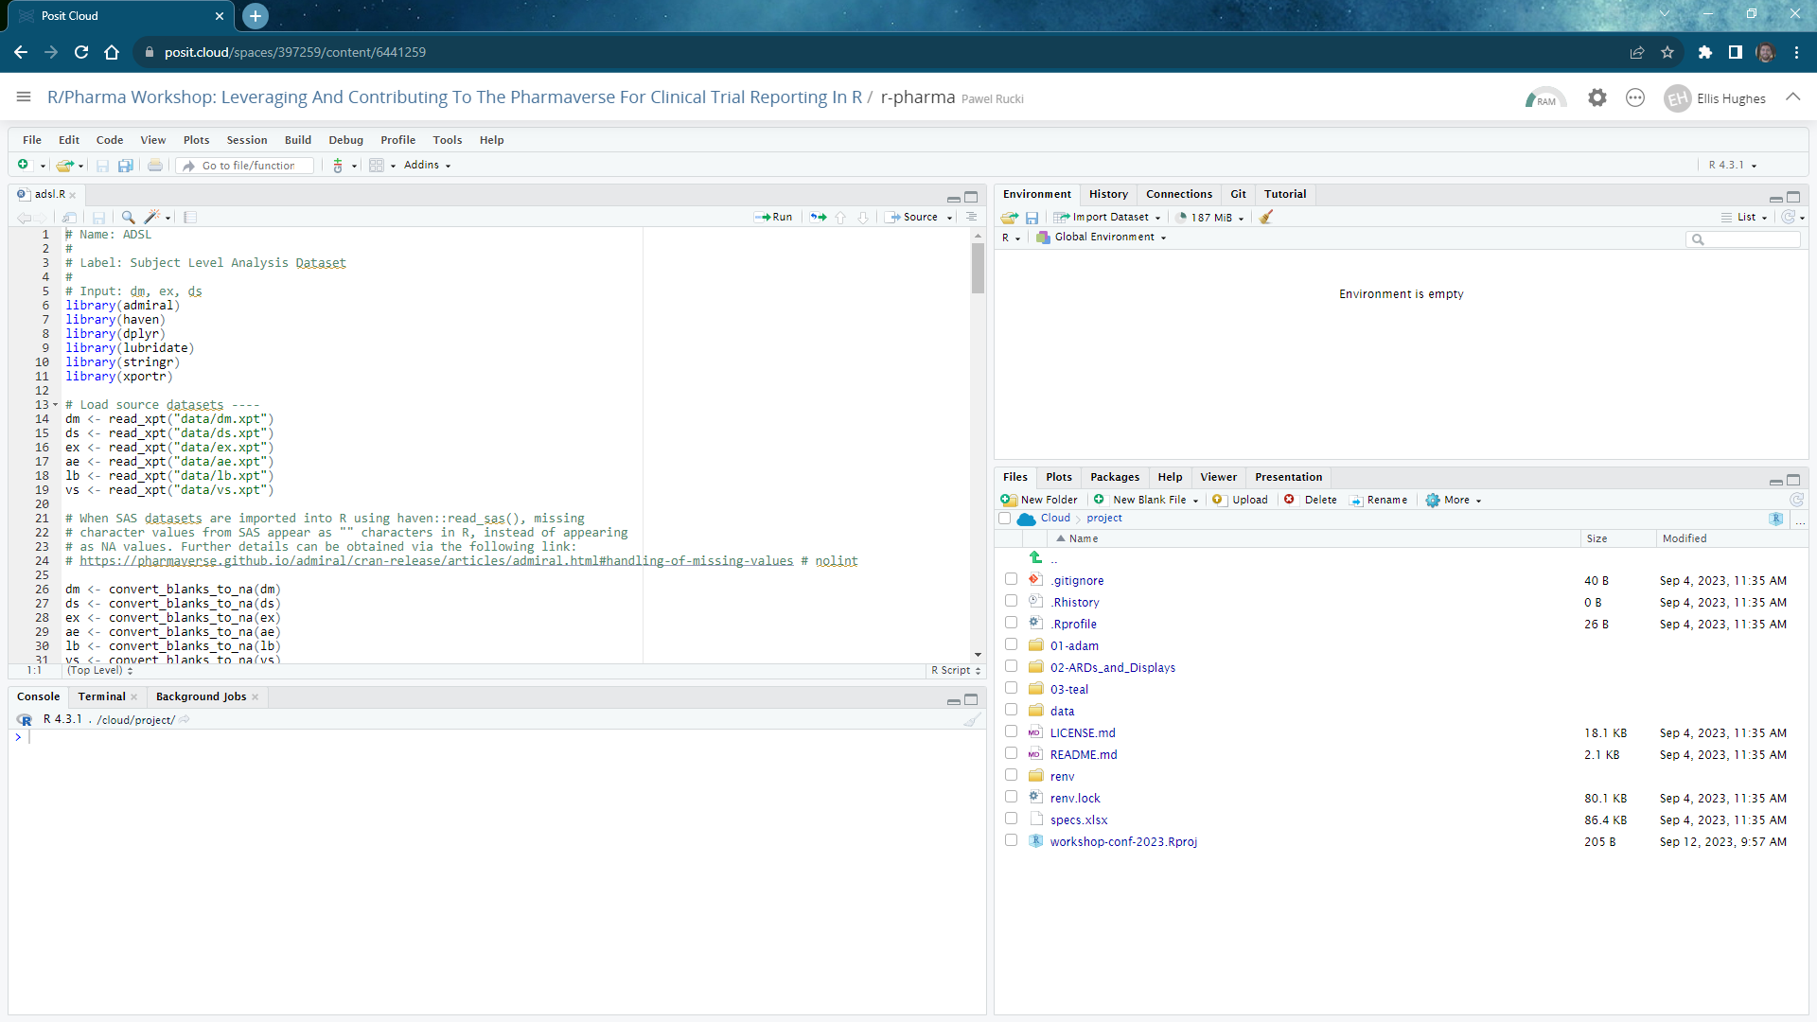

Slide 8
Edit Window/Source

Slide 9
Console

Slide 10
File Pane

Slide 11
Plot Pane

Slide 12
Help Pane

Slide 13
Environment

Slide 14
Time | Activity
09:00 – 09:10 | Introduction
09:10 - 10:30 | Session 1 - ADaM
10:30 - 11:00 | Coffee break
11:00 - 12:30 | Session 2 – ARDs and Displays
12:30 - 13:30 | Lunch break
13:30 - 15:00 | Session 3 - teal
15:00 - 15:30 | Coffee break
15:30 - 17:00 | Session 4 - Contributing

